Slide 1
Competitor Analysis

Slide 2

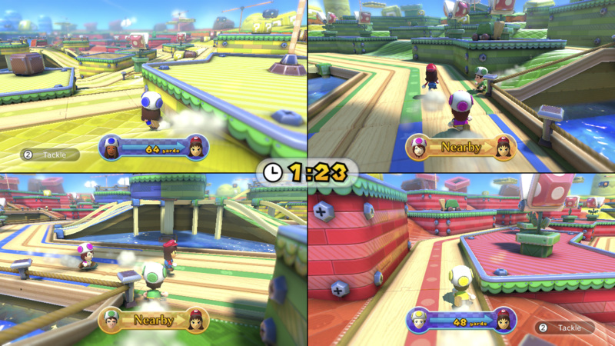
Mario Chase
Co-Operative/Couch-Coop Game
4 Players run around a map, chasing a player. Similarly in my game, 4 players run around a map chasing the player with the best item
3D TopDown
Consists of different Stages which have different layouts and hiding areas
Each round/stage has a timer

Slide 3

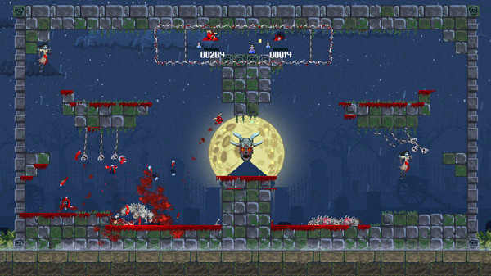
Demons with Shotguns
Couch co-op shooter/fps game
Players chase each other around a platform based 2D map with shotguns
All 4 players can be seen at any time because the camera zooms in and out and follows the players
Very similar style to the levels for my game
However the game is very serious and adult

Slide 4
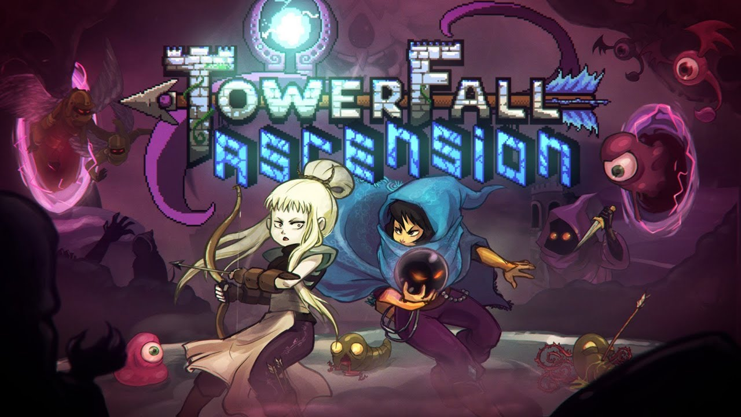
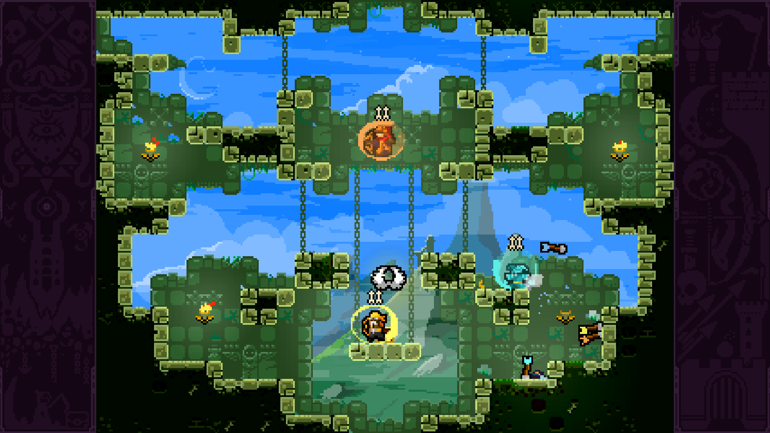
TowerFall Ascension
2D 4 player local party game
Players fight on platform based levels with bows and arrows
“Battle Royale” game

Slide 5
What features can I take from existing games?
Multiplayer follow camera, the camera in my game should zoom in and out so that all players can be seen at any given time
2D “retro” art style
Powerups (items) should be varied and interesting
Gameplay should be simple and easy to understand after a practice round

Slide 6
What makes my game different?
No combat, players can not die which would end the game
More “family-friendly” than other games, there is no violence
Unique idea, could not find any 2D tag games

